Slide 1
Java MVC Group Task
Web Programming with Java Spring MVC
Kelompok-02
Bagus Indiarto
Steady
Jeremy Matthew
Rizal Cerdas
Anindhito Irmandharu

Slide 2
Features
Login (Roles)
Registration
Book CRUD
Add Author & Publisher
View, Add Borrowed Book, Return Borrowed Book (Admin)
View and See History of Borrowed Book (Borrower)

Slide 3
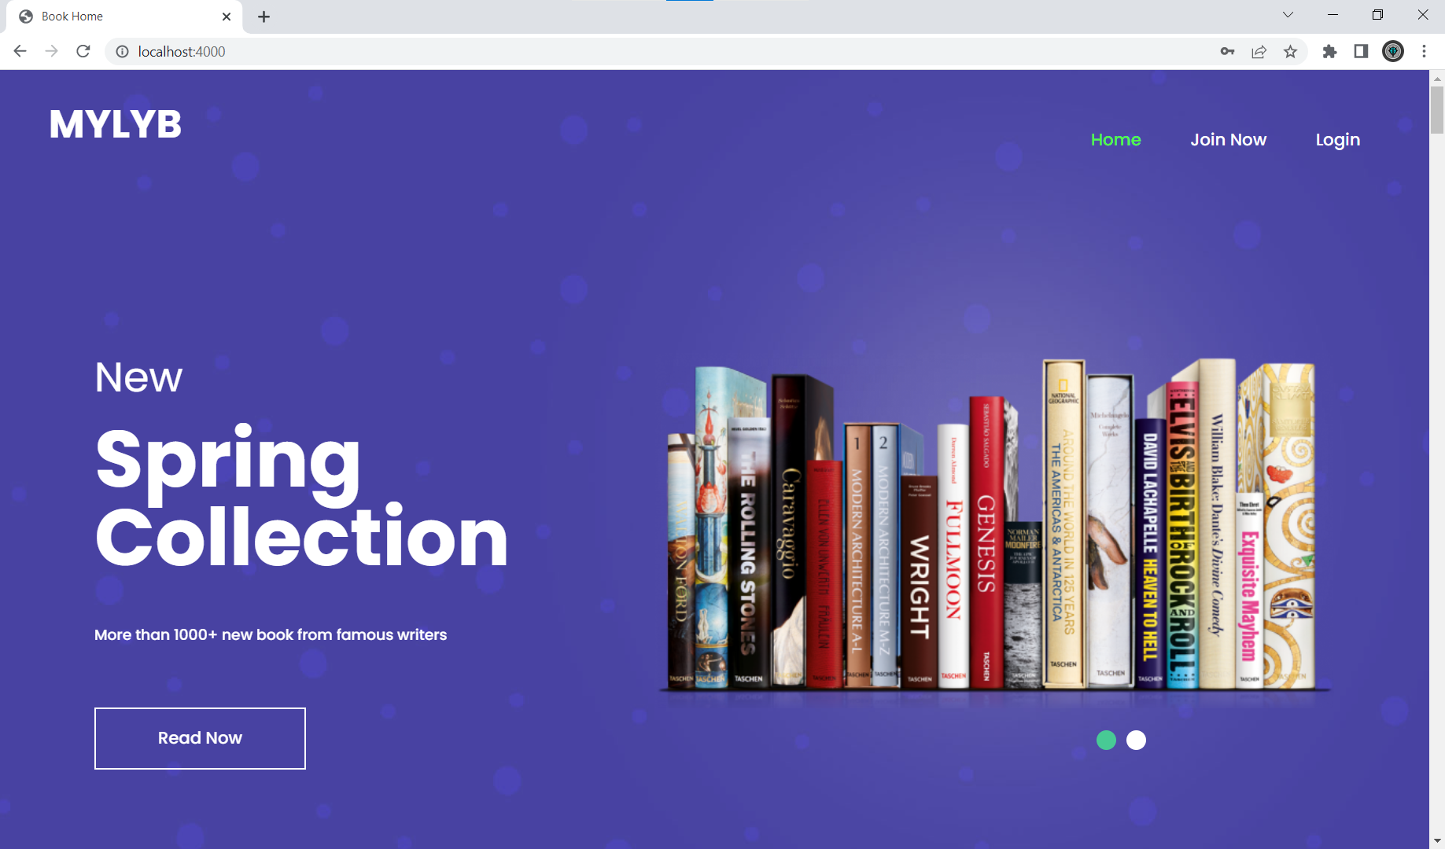
App Demo
The app can be accessed on :
http://localhost:4000
The app can be forked on :
https://github.com/Adhito/app-inixindo-java-spring-task-group

Slide 4


